Slide 1
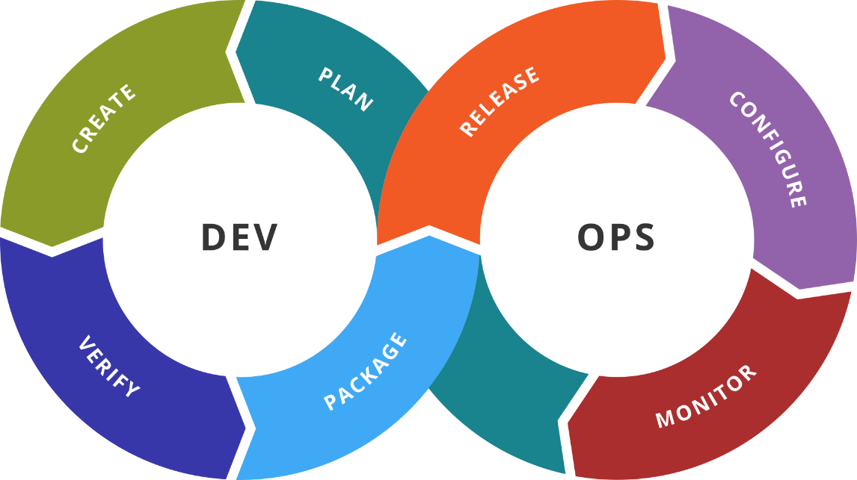
Elastic Stack
SoftUni Team
Technical Trainers
Software University
https://softuni.org

Slide 2
You Have Questions?
sli.do
#DevOps-23
facebook.com
/groups/DevOpsContainerizationCICDMonitoringJanuary2023

Slide 3
Homework Progress
Solutions for M6
can be submitted
until 23:59 on 15.03.2023
Solutions for M7
can be submitted
until 23:59 on 22.03.2023

Slide 4
The End is Near ☺
THIS MODULE
ONE
GO
MORE
AND
TO

Slide 5
Prepare for the Test (Practice Questions)
Test Your Knowledge
https://zahariev.pro/q/do1

Slide 6

Previous Module (M6)
Quick Overview

Slide 7
What We Covered
Prometheus
Architecture
Installation and configuration
Information processing and PromQL
Grafana
Installation and configuration
Dashboarding

Slide 8

Dev
Ops
This Module (M7)
Topics and Lab Infrastructure

Slide 9
Table of Contents
Elastic Stack
Elasticsearch
Logstash
Kibana
Beats
Elastic Stack and Docker

Slide 10
Lab Infrastructure
N1
N2
…
NAT Network
VirtualBox
Vagrant
Windows / Linux / macOS

Slide 11
Dev
Ops
Elastic Stack
ex-ELK Stack

Slide 12
ELK (Elastic) Stack
Started as ELK Stack
Elasticsearch
Logstash
Kibana
Then became Elastic Stack
Beats were added
Then other components
ELK became obsolete as name

Slide 13
Elasticsearch
Used for searching, analyzing, and storing of data
The hearth of the Elastic Stack
Distributed, RESTful search and analytics engine
Designed for horizontal scalability, maximum reliability, and easy management
Supported on multiple platforms
Offered through packaging systems and as standalone package

Slide 14
Logstash
Open source, server-side data collection and processing pipeline
Ingests data from a multitude of sources simultaneously, transforms it, and then sends it to your favorite “stash”
Complemented by extensible plugin ecosystem
Strong Elasticsearch synergy
Processing in three stages – input, filter, and output

Slide 15
Kibana
Used for both data visualization and Elastic Stack navigation
Supports multiple visualizations
Visualizations can be used to create Dashboards
Offers interactive experience

Slide 16
Dev
Ops
Practice: See It in Action
Live Demonstration in Class

Slide 17
Dev
Ops
Beats
Feed the data in

Slide 18
Beats
Platform for single-purpose data shippers
Can send data from hundreds or thousands of machines and systems to Logstash or Elasticsearch
Lightweight - they just gather and send data without processing
Plug & Play - use modules to simplify the process
Extensible - we can build our own

Slide 19
A Few Beats *
Heartbeat
Monitor services for their availability with active probing
Metricbeat
Collect metrics from your systems and services
Filebeat
Offers lightweight way to forward and centralize logs and files
Auditbeat
Audits the activities of users and processes on the systems

Slide 20
Dev
Ops
Practice: See It in Action
Live Demonstration in Class

Slide 21
Dev
Ops
Docker and Elastic Stack

Slide 22
Docker and Elastic Stack
Docker can be monitored as well as its containers
We will explore both scenarios
Furthermore, we will run the whole stack on Docker

Slide 23
Dev
Ops
Practice: See It in Action
Live Demonstration in Class

Slide 24

Resources
Get Started with Elastic Stack
https://www.elastic.co/start
Get Started with Beats
https://www.elastic.co/guide/en/beats/heartbeat/current/heartbeat-getting-started.html
https://www.elastic.co/guide/en/beats/metricbeat/current/metricbeat-getting-started.html
https://www.elastic.co/guide/en/beats/auditbeat/current/auditbeat-installation-configuration.html
https://www.elastic.co/guide/en/beats/filebeat/current/filebeat-getting-started.html
…
…
…

Slide 25
Questions?
Notes:
25

Slide 26














SoftUni Diamond Partners

Slide 27

Educational Partners

Slide 28

License
This course (slides, examples, demos, exercises, homework, documents, videos and other assets) is copyrighted content
Unauthorized copy, reproduction or use is illegal
© SoftUni – https://softuni.org
© Software University – https://softuni.bg
Notes:
28

Slide 29
Trainings @ Software University (SoftUni)
Software University – High-Quality Education, Profession and Job for Software Developers
softuni.bg, softuni.org
Software University Foundation
softuni.foundation
Software University @ Facebook
facebook.com/SoftwareUniversity
Software University Forums
forum.softuni.bg
Notes:
29

